Slide 1

HTML
Lesson 8

Slide 2
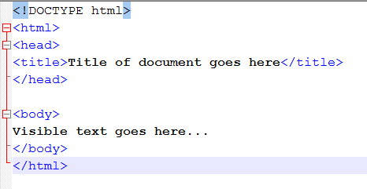
HTML
HTML Basic Document

Slide 3
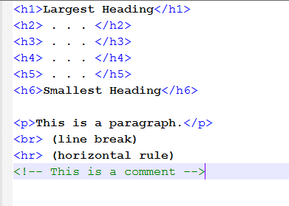
HTML
HTML Basic Tags

Slide 4
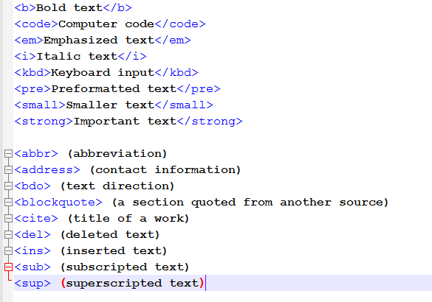
HTML
Formatting

Slide 5
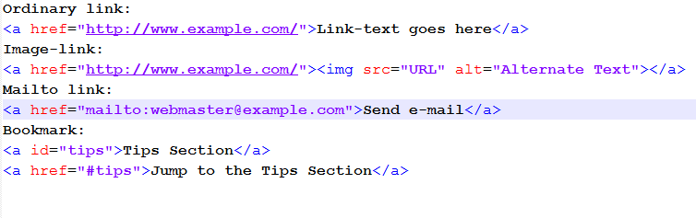
HTML
Links

Slide 6

HTML
Images
Sections

Slide 7
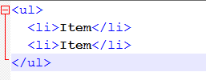
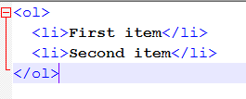
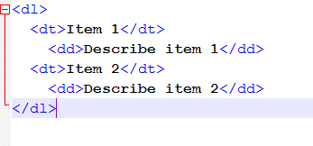
HTML
Unordered List
Ordered List
Definition List

Slide 8
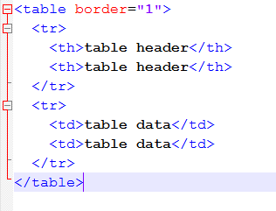
HTML
Tables

Slide 9
HTML
Iframe

Slide 10
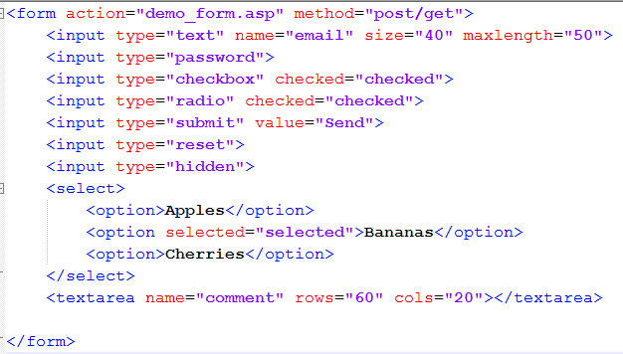
HTML
Forms

Slide 11
HTML
Entities
&lt; is the same as <
&gt; is the same as >
&#169; is the same as ©

